Slide 1





CST2335 GRAPHICAL INTERFACE PROGRAMMING
Week 3 Using Constraint Layout

Slide 2
Agenda
Model View ViewModel

Slide 3
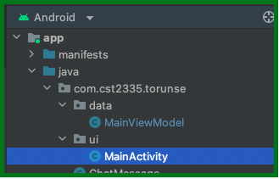
Model View ViewModel (MVVM)
This architecture patter represents a simple way to separate code into different portions to make them easy to maintain in a GUI program
The 3 parts to this patter:
Model: This is plain Java class that represents objects and logic that has nothing to do with the GUI
View: This the page on the screen. This class uses ViewBinding to hold all of the widgets on the page
ViewModel: Class that stores all of the variables representing data on the page shown

Slide 4
Implementing MVVM in Android
The high-level steps are as follows:
Enable ViewBinding in app/build.gradle file
Create a new project
Modify string.xml file
Create the Model class
Working with the activity_main.xml file
Creating the ViewModel class
Define functionalities of View in the MainActivity file

Slide 5
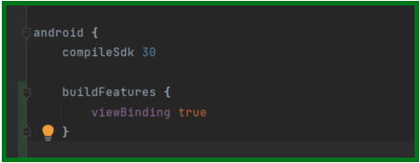
Enable ViewBinding
View Binding is a new technology that automatically loads all of the widgets in your layout and assigns them to Java variables automatically
Set this for your project in app/build.gradle

Slide 6
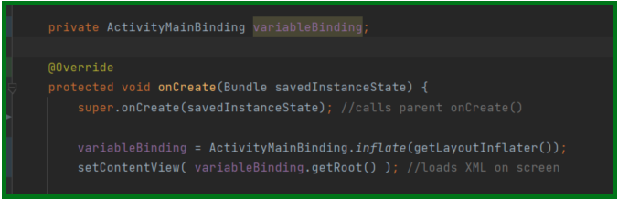
Apply variableBinding in MainActivity
With view binding, you no longer need to call findViewById(), because the compiler has pre-declared all the views in the Binding class.
Replace findViewById(R.id.idName) with variableBinding.idName;

Slide 7
Summary
Use XML to define your layout:
<Text> and <EditText> use android:text="", and android:hint=""
Button uses android:text="", ImageButton uses android:src=""
CheckBox, RadioButton and Switch are all two-state buttons. They use android:checked to specify if they are on or off..
In Java:
After setContentView( ) , use the pattern:
Widget anObject = findViewById(R.id.objectId) ;
Text and EditText use setText() and getText()
Button and ImageButton use: setOnClickListener( e -> { } );
CheckBox, RadioButton and Switch use:
setOnCheckedChange( (btn, checked) -> { } );

